Slide 1
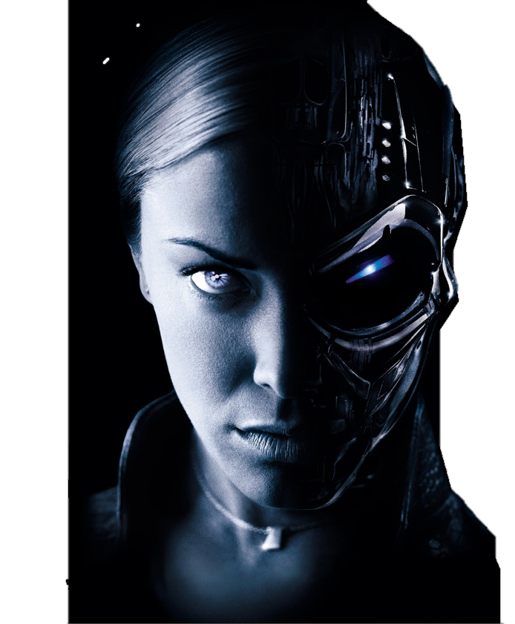

ARTIFICIAL INTELLIGENCE CRIME:

Slide 2
ARTIFICIAL INTELLIGENCE CRIME:

Slide 3
ARTIFICIAL INTELLIGENCE CRIME:
An Overview of Malicious Use and Abuse of AI
Guided by:
Prof. Maria Yesudas
Assistant Professor
Dept. of Computer Science
Presented by:
Allwina Anna Soy Jose
S7-CS-B-10

Slide 4
Course Objectives And Outcomes
Course Objectives
CO1 : Understand the rapid evolution of Artificial Intelligence (AI) capabilities and their impact on various sectors of society.
CO2 : Identify the vulnerabilities of AI models and how malicious actors can abuse them.
CO3 : Explore AI-enabled and AI-enhanced attacks.
CO4 : Learn about the four types of malicious abuse of AI: integrity attacks, unintended AI outcomes, algorithmic trading,
membership inference attacks.
CO5 : Learn about the four types of malicious use of AI: social engineering, misinformation/fake news, hacking, autonomous
weapon systems.
Course Outcomes
CO1 : Gain a comprehensive overview of the risks associated with enhanced AI application.
CO2 : Develop an understanding of the types of activities and corresponding risks related to the malicious use and abuse of AI.
CO3 : Ability to identify and understand the vulnerabilities of AI models.
CO4 : Acquire knowledge about various AI-enabled and AI-enhanced attacks.
CO5 : Understand the need for enhanced collaboration among governments, industries, and civil society actors to increase
preparedness and resilience against malicious use and abuse of AI.

Slide 5

Content:
What is AI ?
What is Artificial Intelligence Crime?
Malicious Abuse of AI
Integrity Attack
Malicious Use Of AI
Social Engineering Attack
Conclusion
Unintended AI Outcomes
Algorithmic Trading
Membership Inference Attack
Misinformation and Fake News
Hacking
Autonomous Weapons Systems
References
Thank You

Slide 6
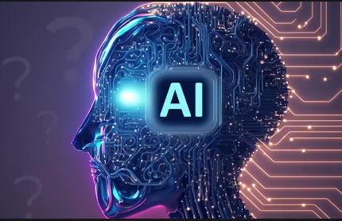
What is Artificial Intelligence ?
● Artificial Intelligence (AI) is the emulation
of human intelligence in machines.
● It encompasses a wide range of
technologies and techniques for tasks like
problem-solving, learning, and decision-
making.
● AI subfields include machine learning,
natural language processing, computer
vision, and robotics.
● AI is used in various industries for
applications such as healthcare, finance,
autonomous vehicles, and virtual personal
assistants.

Slide 7
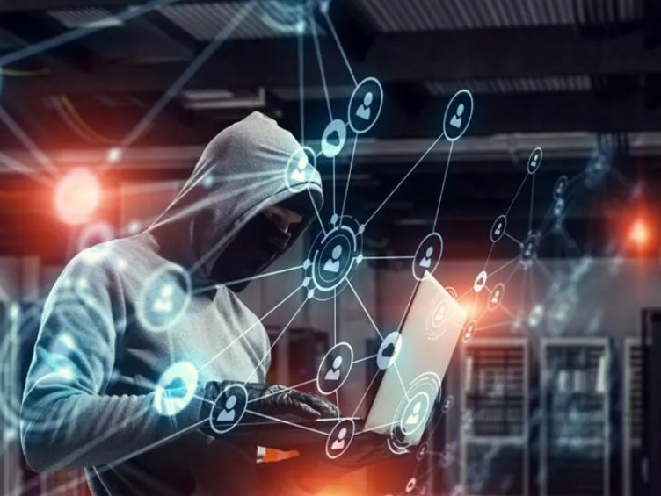
What is Artificial Intelligence Crime?
● "Artificial Intelligence crime" involves
illegal activities using AI technology.
● It includes cybercrimes, hacking,
automated fraud, and unethical
AI practices.
● Discrimination concerns may also fall
under this category.
● Law enforcement and regulators are
taking action to combat AI-related
criminal activities and promote ethical
AI use.

Slide 8
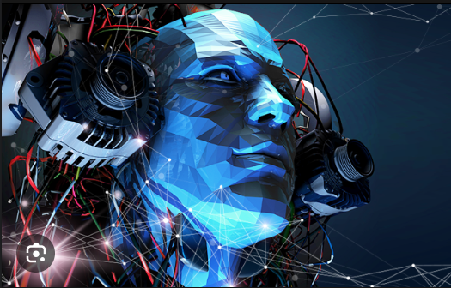
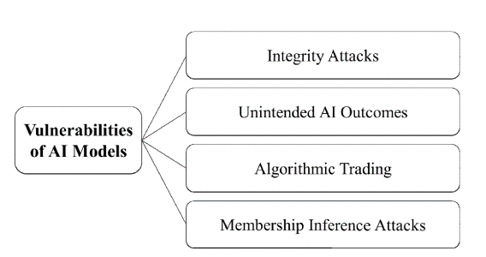
Malicious Abuse of AI
This usually refers to scenarios where existing AI systems or models are manipulated or exploited in a way that causes harm.

Slide 9

Integrity Attacks
● Integrity attacks in AI crime involve malicious
actions by hackers.
● The goal is to inject false information into a
system to corrupt or manipulate data.
● These attacks can seriously undermine the
trustworthiness and reliability of AI systems.
● Machine Learning (ML) models, in particular,
are vulnerable to integrity attacks as they
heavily rely on the quality and integrity of
their training data.
Eg: Tay, Microsoft’s Chatbot

Slide 10

Unintended AI Outcomes
● Unintended AI outcomes are situations where
AI systems behave in ways not intended by
their designers
● These outcomes can pose serious threats to
privacy and security.
● It's crucial to understand that these
unintended outcomes are not a result of the
AI system's intent but rather issues related to
design, implementation, or environmental
interactions.
Eg: Google’s Smart Compose

Slide 11

Algorithmic Trading
It involves the misuse of AI to execute large
orders of trades, manipulate market prices, or
exploit information asymmetry.
In a simulated market experiment, trading
agents could learn and execute a “profitable”
market manipulation campaign comprising a
set of deceitful false-orders.
AI can bring significant benefits to the financial
sector, such as building and training bots that
can trade better than humans do, and
preventing and detecting everything from
routine employee theft to insider trading.
Eg: 2010 Flash Crash

Slide 12
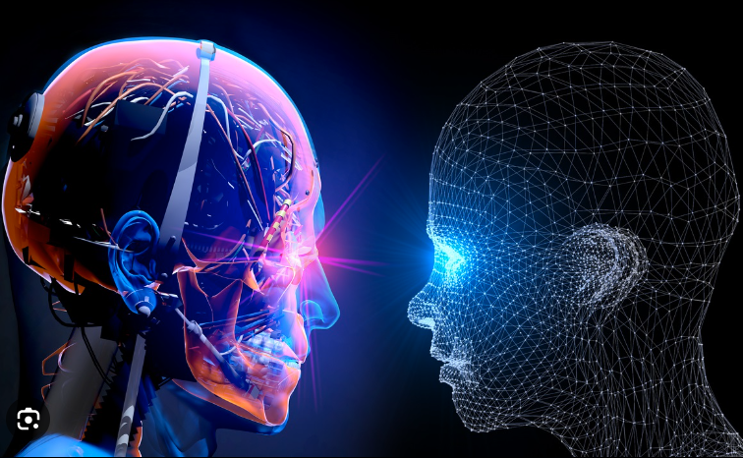
Membership Inference attacks
Adversary queries a trained machine learning
model to determine if a specific example was
part of the model's training dataset.
Adversary uses machine learning to train an
inference model that detects differences in the
target model's predictions between training
and non-training inputs.
This technique leverages adversarial use of
machine learning to uncover information
about the target model's training dataset.
Eg:thispersondoesnotexist.com

Slide 13

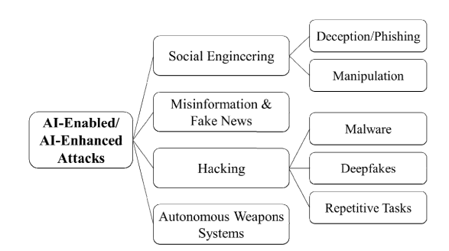
Malicious Use of AI
This typically refers to scenarios where AI is intentionally used to carry out harmful activities

Slide 14
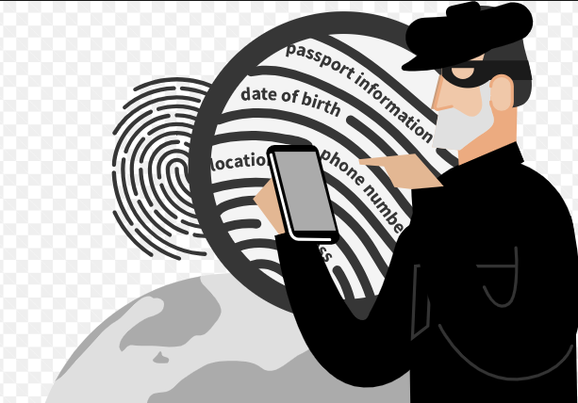
Social Engineering
It uses deception techniques to manipulate
human subjects to share sensitive or personal
information , which can be used for fraudulent
purposes.
Deception and Phishing : The bots are used to
deceive and manipulate people into complying
with their requests. E.g. : Cyberlover
Manipulation : Malicious actors can use AI
techniques to develop algorithms or social bots
to manipulate public opinion.
E.g. : Cambridge Analytica

Slide 15
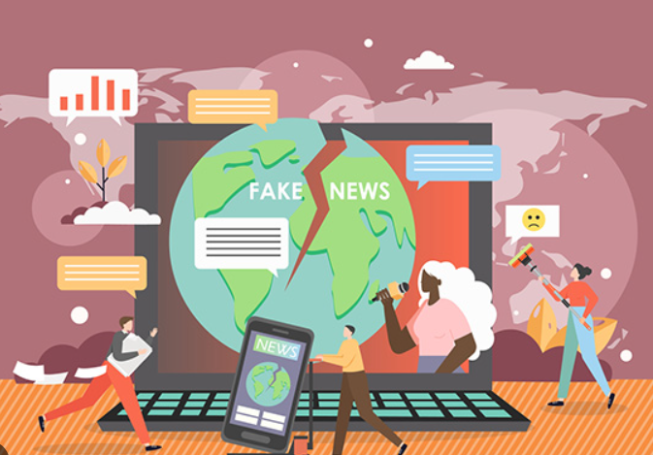
Misinformation and Fake News
Misinformation and Fake News are false or misleading information presented as news.
They spread rapidly through social media platforms, often becoming viral.
They can undermine the electoral process, fuel hatred, and stoke outrage.
Combating them involves fact-checking and raising awareness about their prevalence and impact.
Eg: Tools such as GPT-3

Slide 16
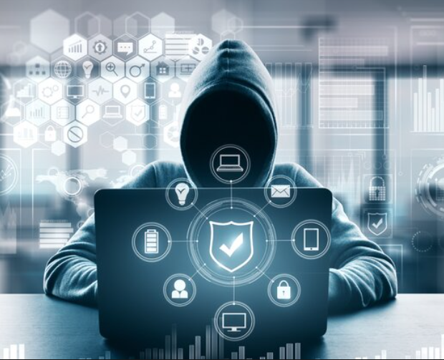
Hacking
Hacking is the act of identifying and then exploiting weaknesses in a computer system or network, usually to gain unauthorized access to personal or organizational data.
Deepfakes : With the advances in AI, algorithms support the creation of hyper-realistic images and videos.
Eg: “fake” Elon Musk joining Zoom meeting.
Repetitive Tasks : AI systems can perform repetitive tasks efficiently, which malicious actors can exploit.
Eg: Captcha-defeating and password cracking.
Malware : It could be enhanced with AI techniques, improving its capibilities.
Eg: DeepLocker

Slide 17
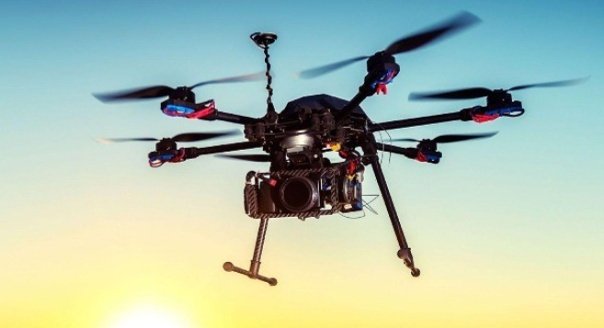
Autonomous Weapons Systems
Autonomous Weapons Systems are weapons that select and apply force to targets without human intervention.
They are triggered by sensors and software, which match what the sensors detect in the environment against a ‘target profile’.
The concern with this process is the loss of human judgement in the use of force. It makes it difficult to control the effects of these weapons.
Eg: hacking the GPS of drones

Slide 18
Conclusion
The capabilities of Artificial Intelligence (AI) evolve rapidly and affect almost all sectors of society¹.
AI has been increasingly integrated into criminal and harmful activities, expanding existing vulnerabilities, and introducing new threats¹.
The article provides an overview of the risks of enhanced AI application, contributing to the growing body of knowledge on the issue¹.
It suggests four types of malicious abuse of AI (integrity attacks, unintended AI outcomes, algorithmic trading, membership inference attacks) and four types of malicious use of AI (social engineering, misinformation/fake news, hacking, autonomous weapon systems)¹.
Enhanced collaboration among governments, industries, and civil society actors is vital to increase preparedness and resilience against malicious use and abuse of AI¹.

Slide 19
References
[1] K. Crawford, Atlas of AI: Power, Politics, and the Planetary Costs of Artificial
Intelligence. London, U.K.: Yale Univ. Press, 2021.
[2] D. Garcia, ‘‘Lethal artificial intelligence and change: The future of international
peace and security,’’ Int. Stud. Rev., vol. 20, no. 2, pp. 334–341, Jun. 2018, doi:
10.1093/isr/viy029.
[3] T. Yigitcanlar, K. Desouza, L. Butler, and F. Roozkhosh, ‘‘Contributions and risks of
artificial intelligence (AI) in building smarter cities: Insights from a systematic
review of the literature,’’ Energies, vol. 13, no. 6, p. 1473, Mar. 2020, doi:
10.3390/en13061473.
[4] Cybercrime. United Nations: Office Drugs. Accessed: May 19, 2021.
http://www.unodc.org/unodc/en/cybercrime/index.html
[5] O. Osoba and W. Welser IV, The Risks of Artificial Intelligence to Security and the
Future of Work. Santa Monica, CA, USA: RAND Corporation, 2017, doi:
10.7249/PE237.

Slide 20


